Slide 1
Diesel Regression
Presented By: Lucas | Fredrik | Ankit
Estimating The Cetane Number of Diesel Fuel

Slide 2
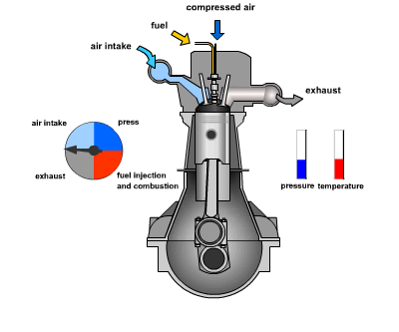
Introduction
The two dominating types of internal combustion engines today are the Otto and Diesel engines.
The resistance of petrol fuel to ignite from compression is specified by its octane number.
In the diesel engine, the willingness of the diesel fuel to ignite and burn is specified by cetane number.
Normally the cetane number of diesel fuel is around 50 but can sometimes be as low as 40. Premium diesel has cetane number closer to 60.

Slide 3
Introduction
The task in this project was to estimate the cetane number from samples of diesel fuel using the near-infrared spectrum (NIR-Spectrum).
We were given two data sets of measured NIR-spectrum out of which, in one of the sets we have access to the actual cetane number.
Using some of the common supervised learning regression methods we have tried to predict the cetane number of the sample set for which the cetane values are unknown to us.
We also tried to predict the accuracy of our predictions. i.e., the estimated generalization errors.

Slide 4
Tools Used
We have used MATLAB.
  We have utilized standard MATLAB script editor for writing m-files.
  And MATLAB apps available to predict cetane numbers.
Apps used
  Regression learner from Statistics and Machine learning toolbox.
  Neural Net Fitting-app from the Neural Net toolbox.

Slide 5
Methodology
Linear regression model with Principal Component Analysis (PCA)
  App and script
  Optimize the number of PCA-components used
  Estimate generalization error
Partial least squares (PLS)
  Script
  Optimize the number of PLS-components used
  Estimate generalization error
Multi-Layer Perceptron (MLP)
  App and script
  Optimize the number units in the hidden layer and the number of PCA-components used
  Estimate generalization error
5-fold cross validation is used to estimate the generalization errors

Slide 6
Data
The data-set that we were given consists of a total of 245 observations of the NIR-spectrum, where every observation has 401 channels.
For 112 of these observations we have no access to the correct cetane number.
The data-sets are the following:
  cnTrainX - 133 observations of NIR-spectrum for which we have the correct cetane number
  cnTrainY - The correct cetane numbers of the 133 samples cnTrainX
  cnTestX - 112 observations for which we don’t have the correct cetane number
cnTrainX
cnTrainY
cnTestX
cnTestY

Slide 7
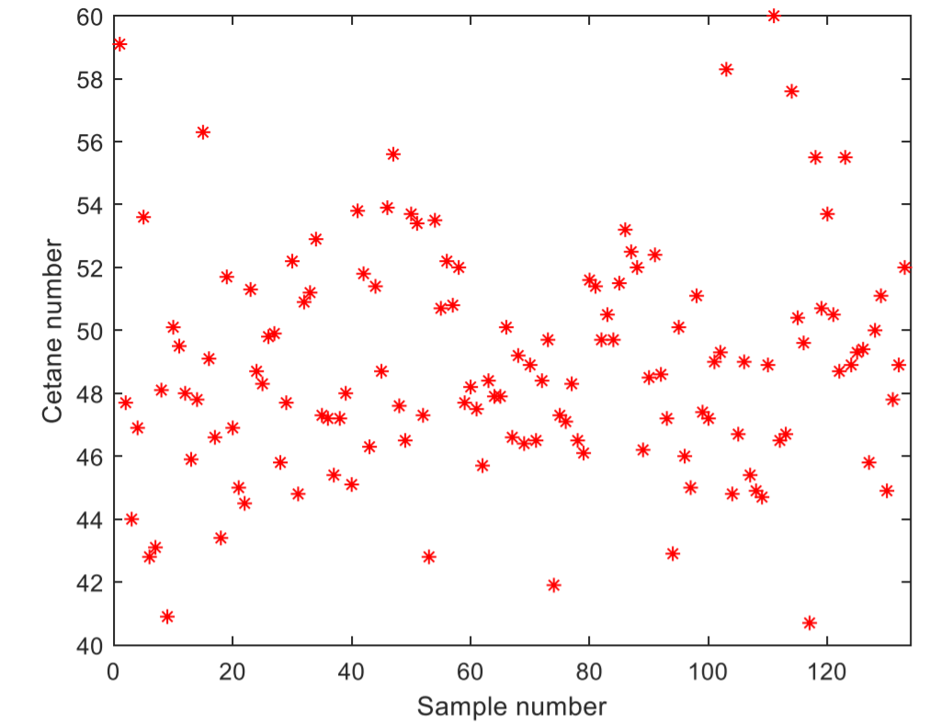
Data
Looking at the cetane number in cnTrainY, i.e., 133 observation we see that it has a range of 40.7 to 60.
The mean value is 48.9.
This was consistent with what we expected the range to be.
All the cetane numbers of cnTrainY is plotted in figure.

Slide 8
Data
Looking at the data found in cnTrainX i.e., the NIR-spectrum, we can point out that it is hard to do any intuitive analysis of the content since we have no specification of how the NIR-spectrum is measured and formed.
The numerical values of the data in cnTrainX have a range of -0.0398 to 0.0618.
The range of data in cnTestX is -0.0399 to 0.0601, hence, not significantly deviating from the range of cnTrainX.

Slide 9
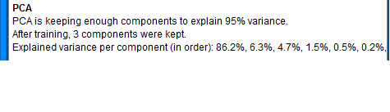
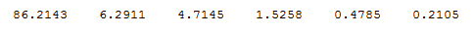
Results
Linear regression model with Principal Component Analysis (PCA)
3 PCA-components used
Estimated generalization error: MSE 4.64 RMSE 2.15

Slide 10
Results
Partial Least Squares (PLS)
Used in PCA
Used in PLS
cnTrainX
cnTrainY
cnTrainX
cnTrainY

Slide 11
Results
Partial Least Squares (PLS)
5 PLS-components used
Estimated generalization error: MSE 4.02 RMSE 2.01

Slide 12
Results
Multi-Layer Perceptron (MLP)
10 units in the hidden layer and 5 PCA-components used
Estimated generalization error: MSE 4.04 RMSE 2.01

Slide 13
Results
PCA
PLS
MLP

Slide 14
Conclusions
We noticed that after using different algorithms to do the prediction, the result were very similar.
This was not seen only in actual predictions, but also the estimations of the generalization error.
Another thing that caught our attention was the difference in behavior of the validation error curves of the PCA & PLS- implementations.
We noticed that there is much more of “sweet spot” for the optimal value of the components to keep when using the PLS-model.
The number of components to keep in the PCA-case was not that obvious.

Slide 15
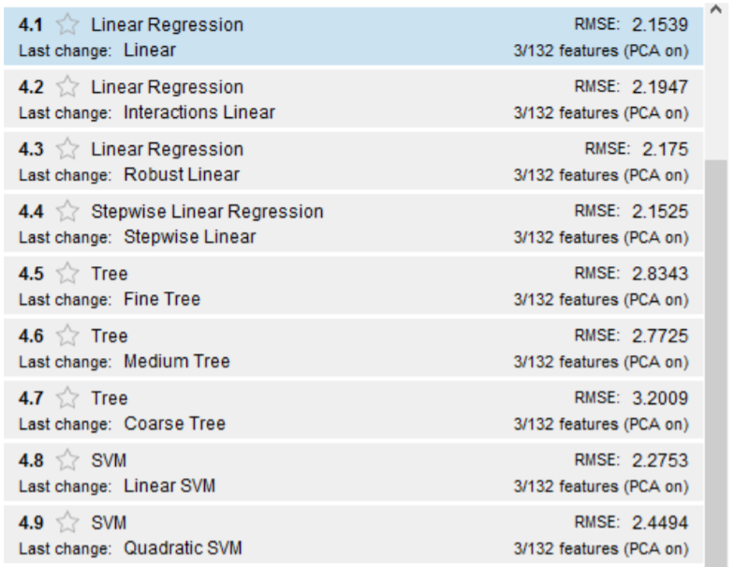
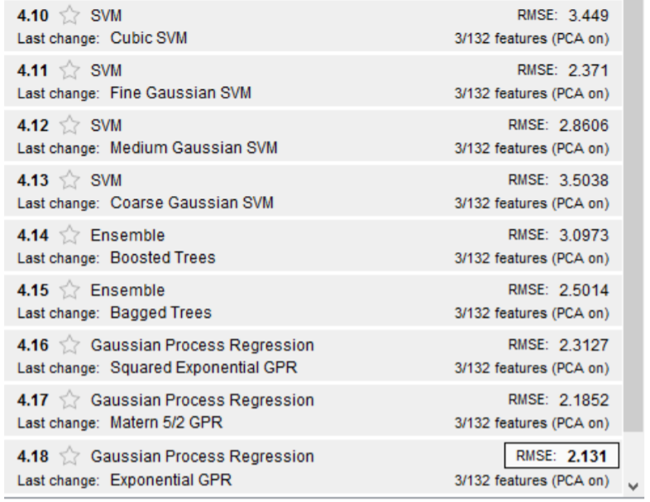
Conclusions
A traditionally script based software such as MATLAB nowadays also have quite a lot of easy-to-use apps making machine learning more available.
We can easily be used to compare different models just by simply choosing to implement all available models at the same time.

Slide 16
Thank you
Questions?

Slide 17
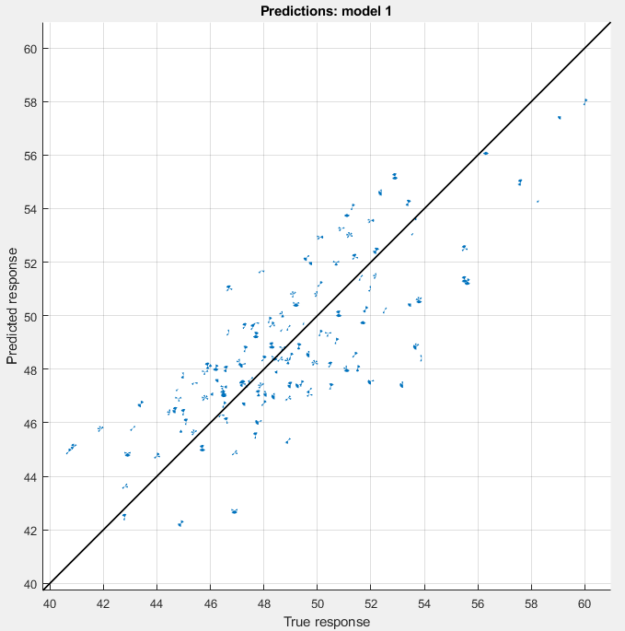
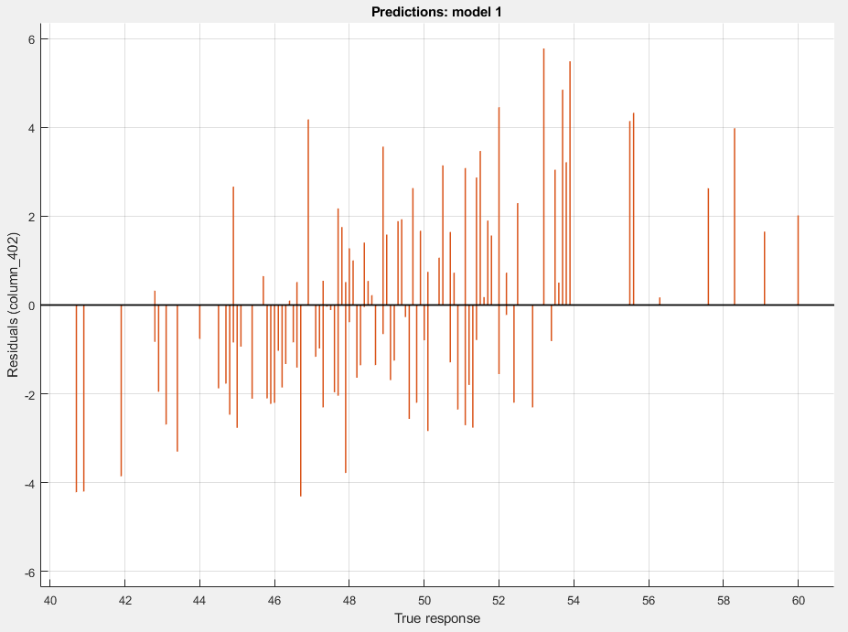
Additional pictures
PCA app

Slide 18
Additional pictures
PCA

Slide 19
Additional pictures
PLS

Slide 20
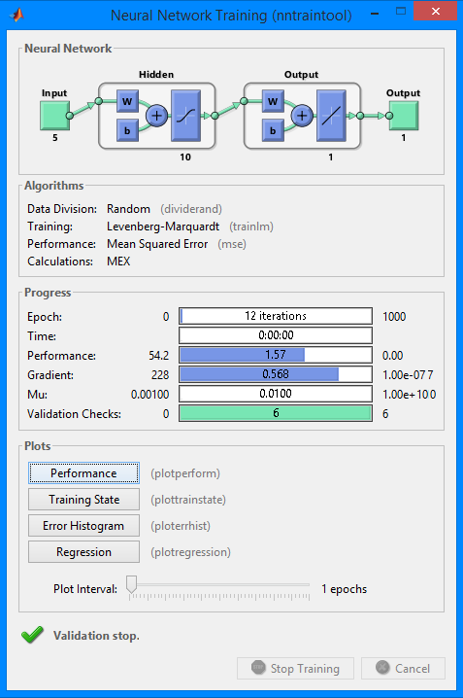
Additional pictures
MLP

Slide 21
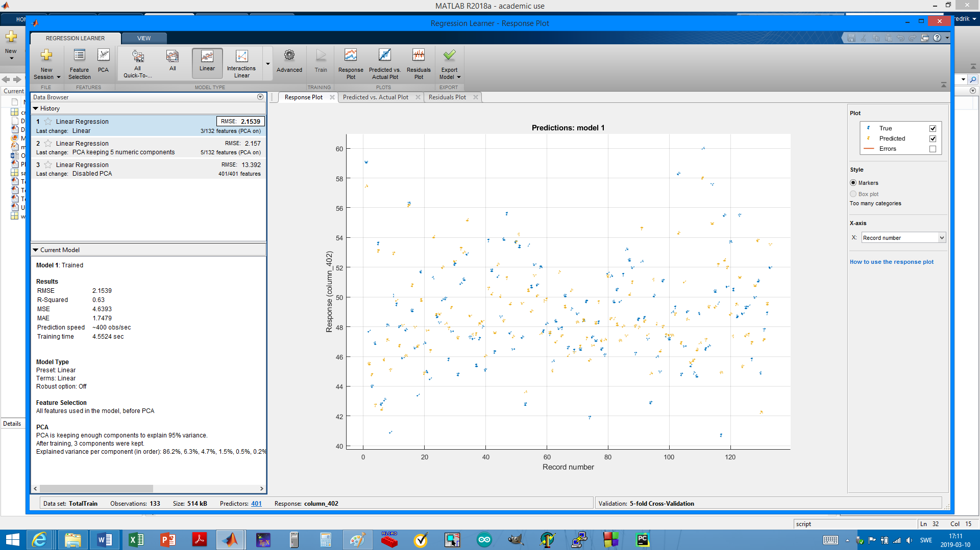
Additional pictures

